Slide 1
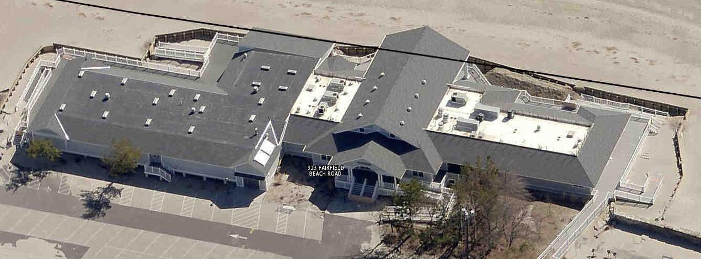
Penfield Pavilion Status Report
January 20, 2015
Presented by:
Penfield Building Committee - James Bradley, Chair
Robert Bellitto, Vice Chair, Andrew Graceffa, Secretary
Ian Bass, Jane Nelson, Ken Jones, Ellery Plotkin, Richard Speciale
Kevin Chamberlain, DeStefano & Chamberlain

Slide 2
Presentation Agenda
Committee Charge
Site Protection
Research & Due Diligence, Considerations
Repair Options
Background
Recommended Design Detail
Bulkhead Improvements

Slide 3
Penfield Building Committee
Formed by Board of Selectmen in December 2013
Key Elements of Committee Charge
Review and recommend options and manage the repair of the Penfield Pavilion.
Be guided by engineering analysis, coastal and geotechnical engineering reports, FEMA standards, flood mitigation, technical reports.
Be guided by public comment and neighborhood concerns.
In evaluating options consider, minimizing ongoing maintenance, incorporating “green” initiatives and “time tested” design features.
Maximize opportunities for FEMA reimbursement.
Consider and integrate any flood mitigation measures.

Slide 4
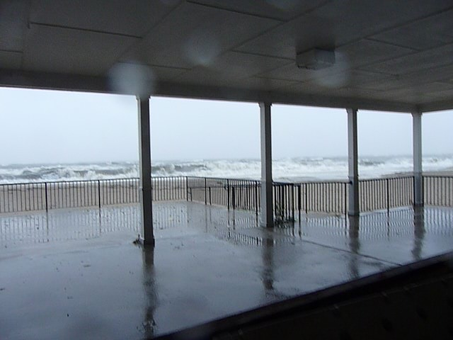
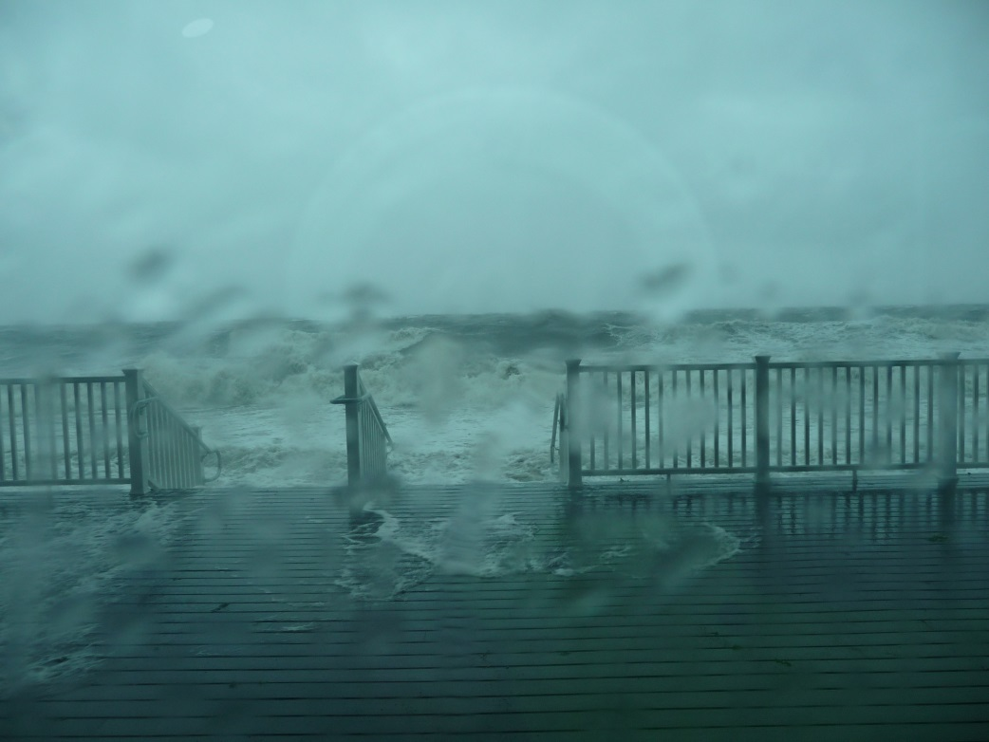
Tropical Storm Irene - 2011
High winds/astronomical high tides;
Storm surge but low wave energy

Slide 5
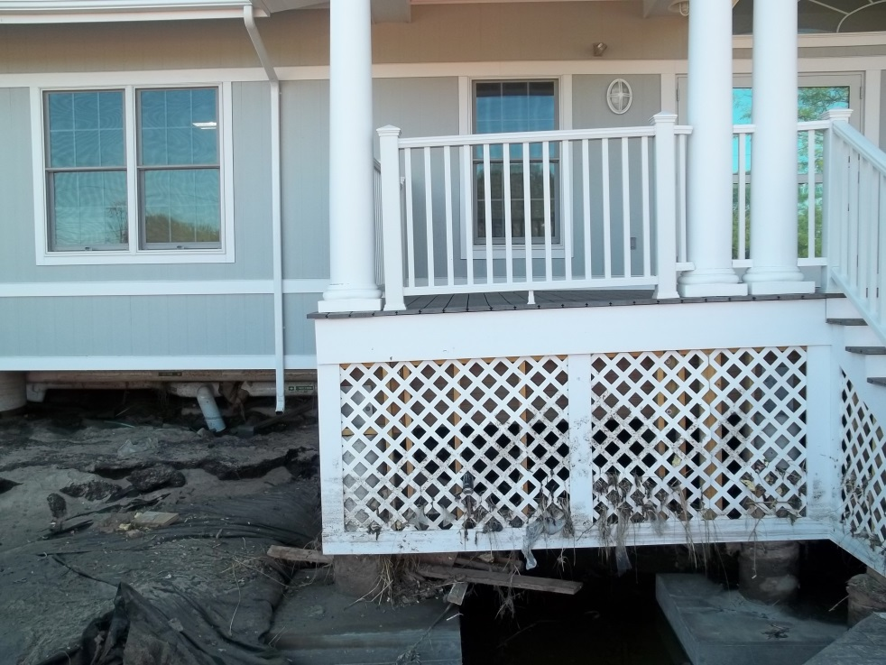
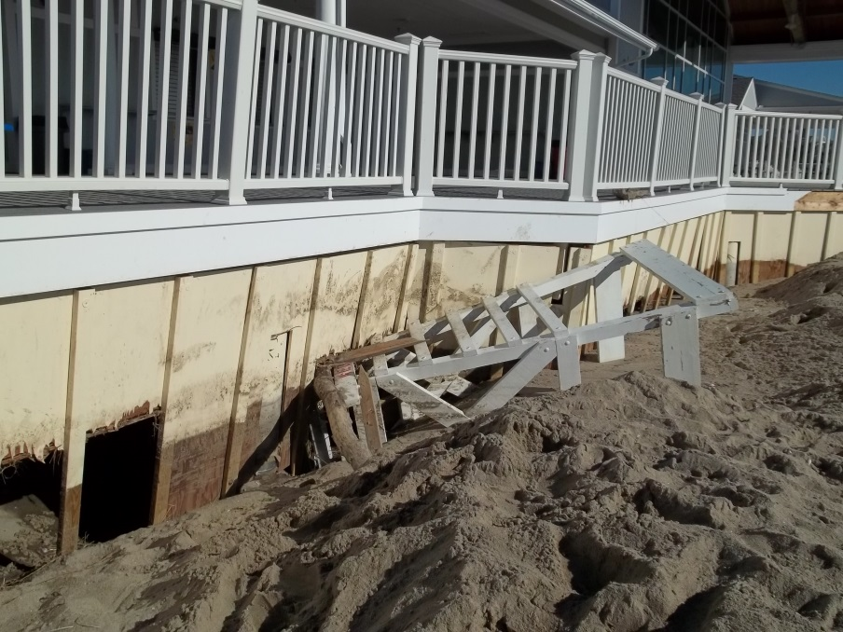
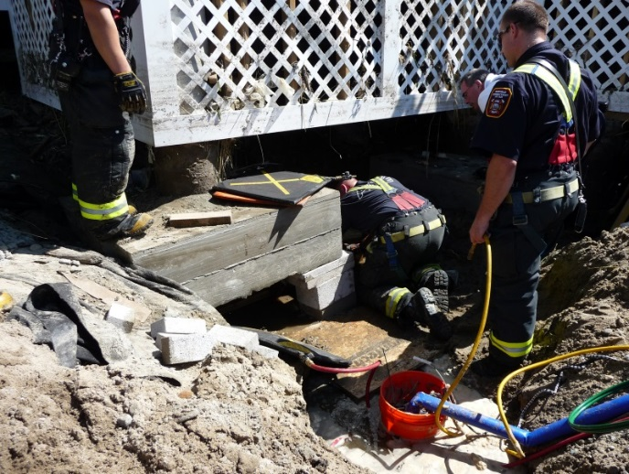
Tropical Storm Irene - 2011
Impact to the Pavilion
Erosion of sands underneath the building
Several footings undermined
Front entrance porch settled

Slide 6
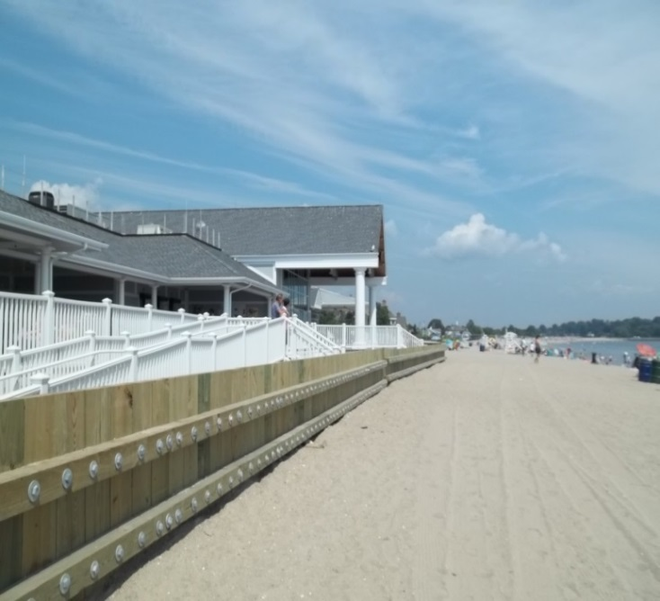
Irene Restoration
Restoration of the Pavilion Included:
Underpinning performed
Protective bulkhead designed and constructed
Building structure repaired and reopened
Certain recommended modifications not completed

Slide 7
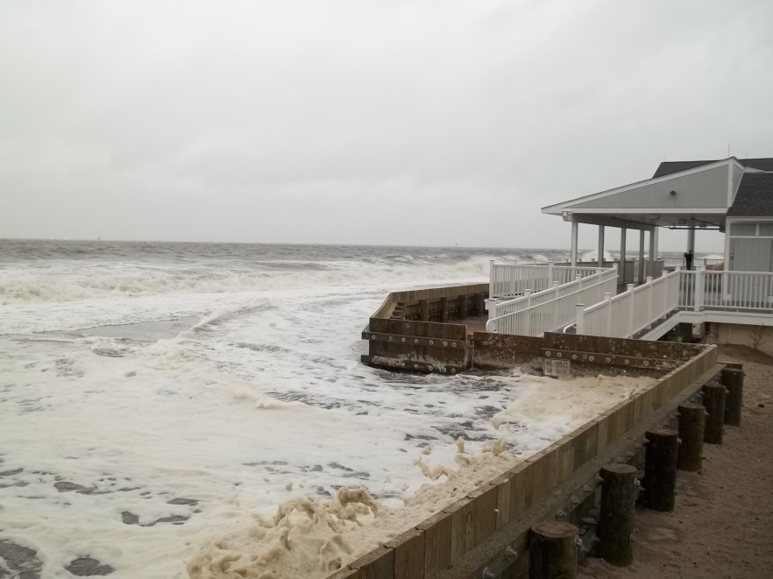
Tropical Storm Sandy - 2012
Category 2 Hurricane downgraded to a post-tropical cyclone. High winds and storm surge.

Slide 8
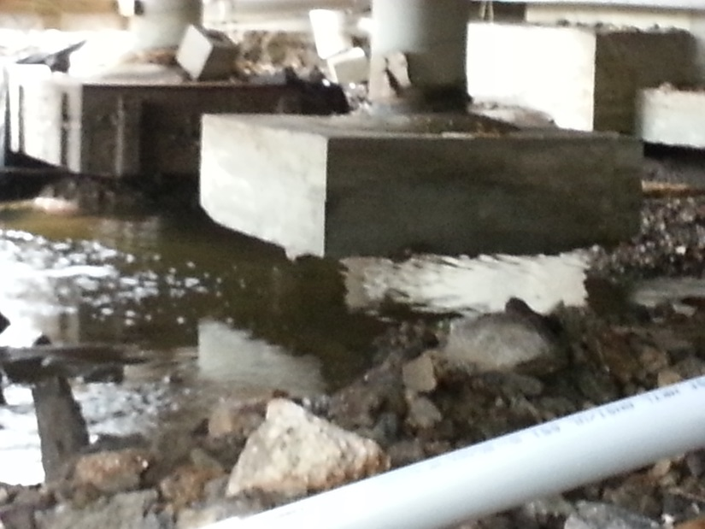
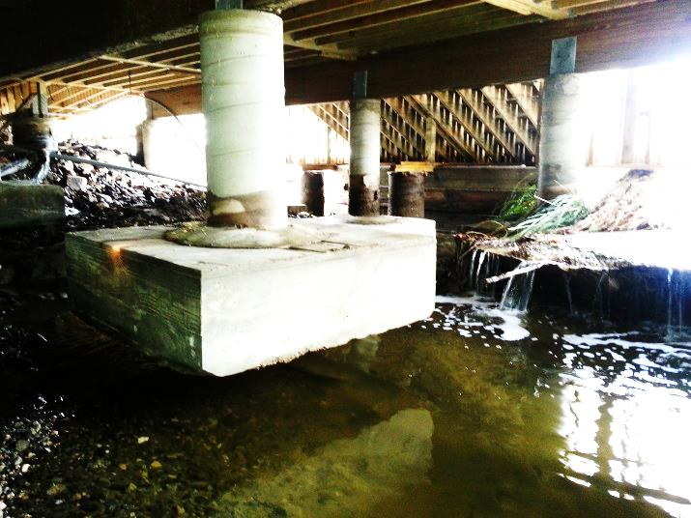
Tropical Storm Sandy Damage
Impact to the Pavilion
Existing spread footings performed poorly
Loss of beach
Sand behind bulkhead liquefied
Sands surrounding and under footings eroded/scoured
Existing bulkhead opening provided a convenient channel for sand transport and funneled flood waters – increasing velocity

Slide 9
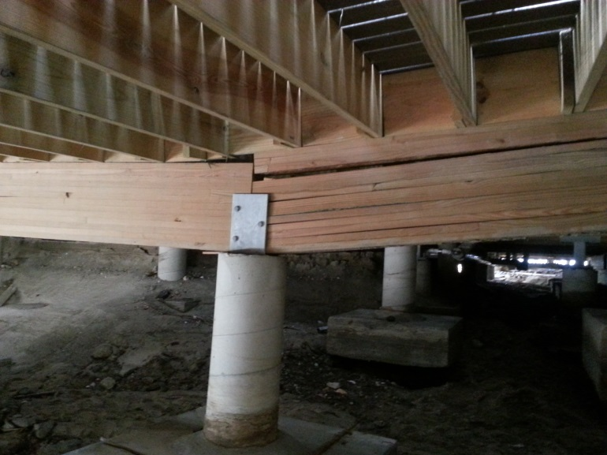
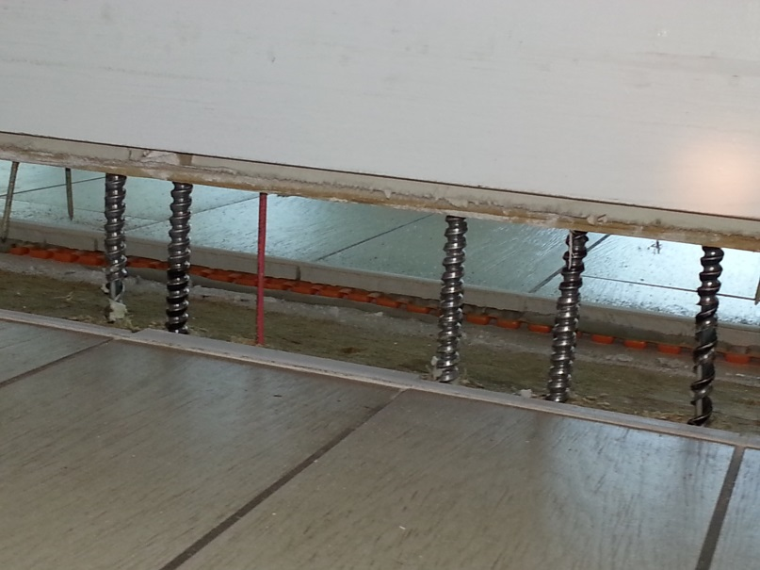
Tropical Storm Sandy Damage
Impact to the Pavilion
Foundation settlement
Structural damage
Damaged building systems and finishes
Building deemed unsafe by Town Building officials

Slide 10
Post Sandy Investigations and Reports
Structural engineer inspection of storm damage – footings, structure and interior.
Mechanical, electrical and plumbing systems not inspected.
Coastal engineer study of impacts of coastal storms.
Geotechnical study, soil borings (testing) and report.
Repair scope of work and cost estimating.
Additional soil borings adjacent to and under building.
Structural re inspection fall 2014

Slide 11
2014 Site Protection
Committee approved additional protection and make-safe safety measures:
Additional security fencing
Inspection of gas and electrical systems
Installed alarm/security system
Temporary Removal of Gathering Hall Glass
In storage for reuse
Permanent closure of openings in bulkhead

Slide 12
PBC – Research and Due Diligence
Original Penfield Phase I and Phase II construction documents
Investigative engineering reports (Irene and Sandy)
JM Albaine Engineering
Roberge Associates Coastal Engineers
Heller and Johnsen Geotechnical Engineers
Storm damage insurance claim, repair, scope and cost estimates
Wakelee Associates
Romano Construction
Saugatuck Construction Group
Engineer, Architect and Construction Manager interviews
Competitive interview and selection April/May 2013
DeStefano & Chamberlain and Shawmut Design & Construction selected
Public input

Slide 13
PBC – Research and Due Diligence
Presentations before the Committee:
JM Albaine Engineering (including results of 8/2013 Public Forum)
Roberge Associates Coastal Engineers
Heller and Johnsen Geotechnical Engineers
Fairfield DPW and Engineering Departments
Building Department
Conservation Department
Parks and Recreation Director
Town Plan and Zoning (including FEMA/Flood Zone requirements)
Town Risk Manager (insurance settlement)
Flood and Erosion Control Board
Report regarding additional soil borings

Slide 14
PBC – Factors Considered
Extent of foundation damage | Beach accretion and loss
Cause of damage/Contributing factors | Existing timber bulkhead location/performance
Feasibility of Repairs | Facility /site impact on neighborhood flooding
Existing site soil conditions | Constructability and project safety
Footing depths | Building height and mass – impact on neighborhood
Alternate foundation designs and soil bearing quality/capacity | Project Cost
Coastal Storm Impacts – past and future | Cost recovery funding resources
Coastal Storm protection | Insurance Claims
FEMA Flood Zone Requirements | Schedule
FEMA Reimbursement Rules | Chief Fiscal Officer Financial Summary

Slide 15
Repair Options
PBC reviewed 11 repair options to varying degrees
8 options were reviewed during the 8/14 Committee meeting
3 options were added after the 8/14 meeting (two in response to public comment)
5 repair options given final consideration
Repair & Protect (Option 1)
Complete Demolition & Site Reconstruction (Option 8)
Demolition & Construct Smaller Facility (Option 9)
Modify & Raise Building (Option 7)*
Modify & Raise Building and Reconstruct East Wing (Option 7A)
* The Committee originally approved Option 7. Option 7A was subsequently approved after financial information based on FEMA rules were provided by the Chief Fiscal Officer and endorsement given by the Parks and Recreation Department.

Slide 16
Background
Pavilion Appraised Value: $5,400,000 (determined during insurance settlement)
Current FEMA requirements must be followed if the value of the repair is greater then 50% of the appraised value of the building.
Pavilion actual construction cost would need to be no greater than $2,650,000
Coastal and Structural Engineering Recommendation: the building should be re-supported on a new flood-resistant pile foundation system

Slide 17
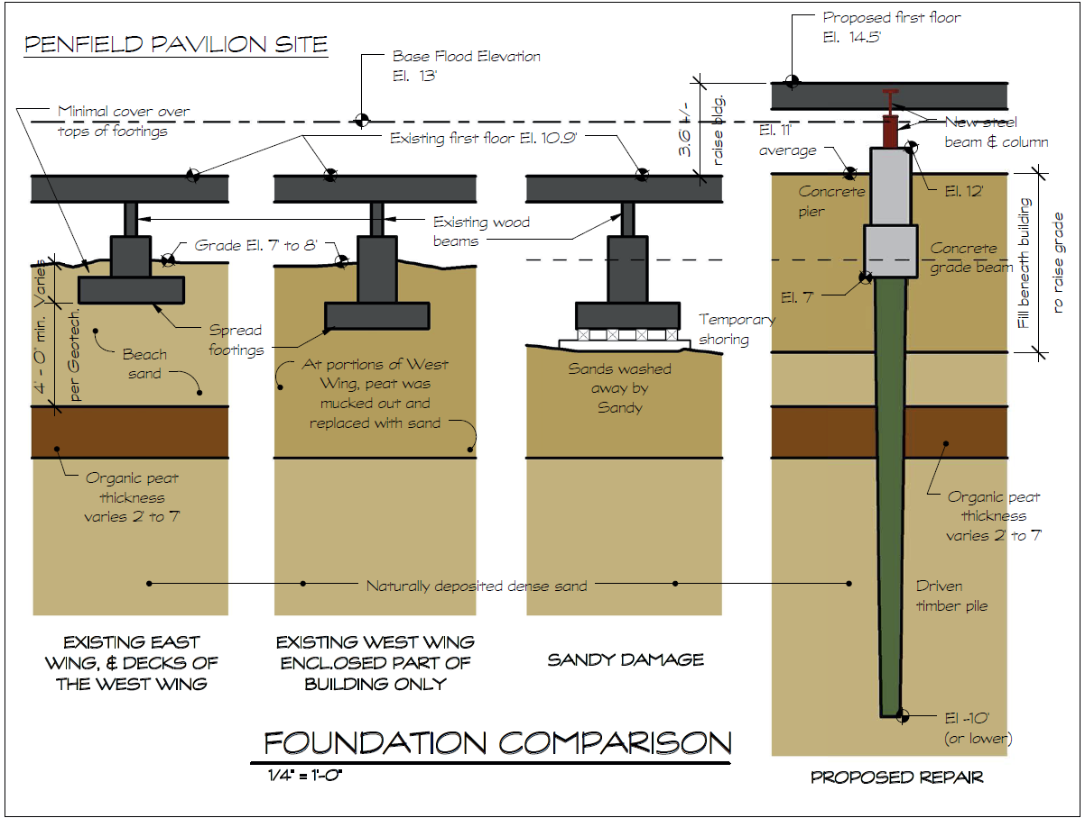
Background (cont’d)

Slide 18
Background (cont’d)
Site FEMA Flood Zone changed from an A zone (moderate wave action) to a V zone (high velocity wave action)
Original construction was FEMA AE Zone
AE zone: Base Flood Elevation (BFE) of 11.0’ finish floor
V zone: Base Flood Elevation (BFE) of 13.0’
(Note: measured to lowest horizontal structural element)

Slide 19
Background (cont’d)

Slide 20
Option 7A Repair and Reconstruct Committee Recommended Approach
Demolish the East Wing and exterior decks
Not financially practical to move – tear off and reconstruct
Lift/move the West Wing building into the parking lot
Repair structural and non-structural damage
Construct new pile supported foundations for East and West Wings
New steel elements supporting floor structure
Redesign and reconstruct East Wing
Create a new, continuous berm connecting Durrell Pavilion to Rickards Beach

Slide 21
Option 7A Repair and Reconstruct Committee Recommended Approach (cont’d)
Move West Wing back in place, 3.5’ higher in elevation
Repair any remaining damage
Fill beneath and around the building
Construct on grade decking, new stairs and ramps
Finished elevation of the site will be +12’
Estimated total project cost: $6,028,709

Slide 22
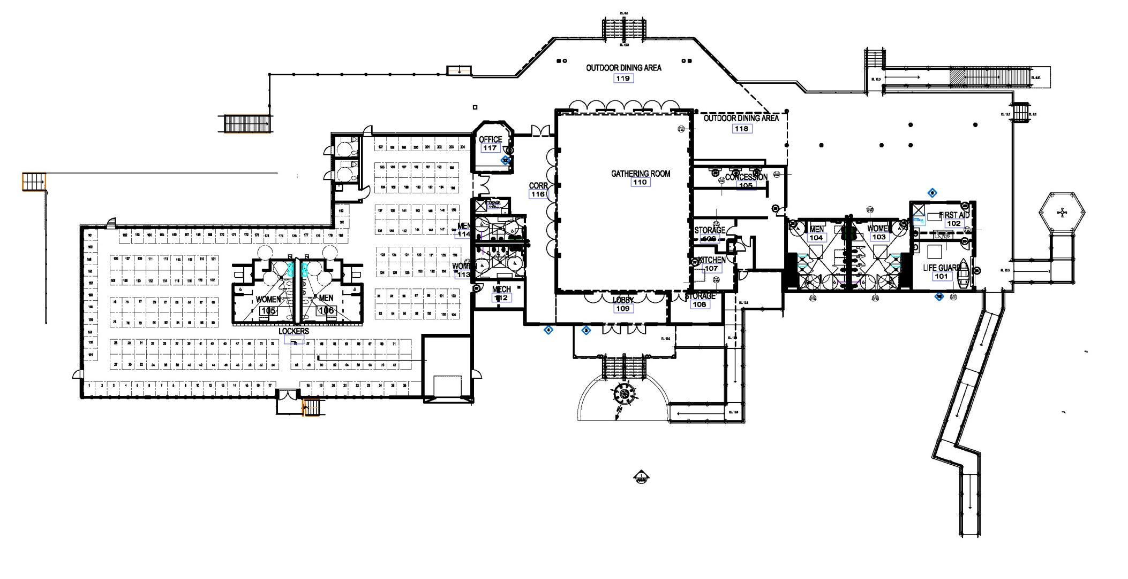
Partial Demolition
Remove Existing Elevated Decks, Ramps and Stairs. Roofs To Remain
Existing Locker Wing, decks and stairs to be Demolished

Slide 23
Move Building
Temporary building location

Slide 24
Install Foundations
Cut back existing floor joists
Remove existing dropped wood beams
Install galvanized steel beams with wood blocking
Pier
Install galvanized steel stub column down to concrete pier
Grade beam
Timber pile

Slide 25
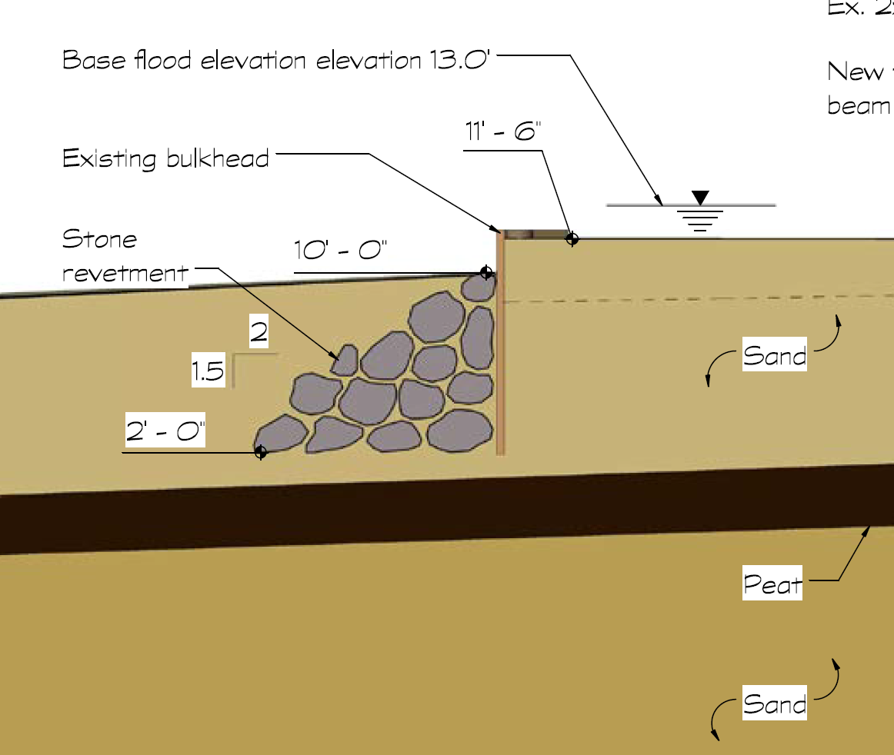
Bulkhead Improvements
Infill ALL openings in accordance with original design
Riprap stone revetment on Long Island side of bulkhead

Slide 26
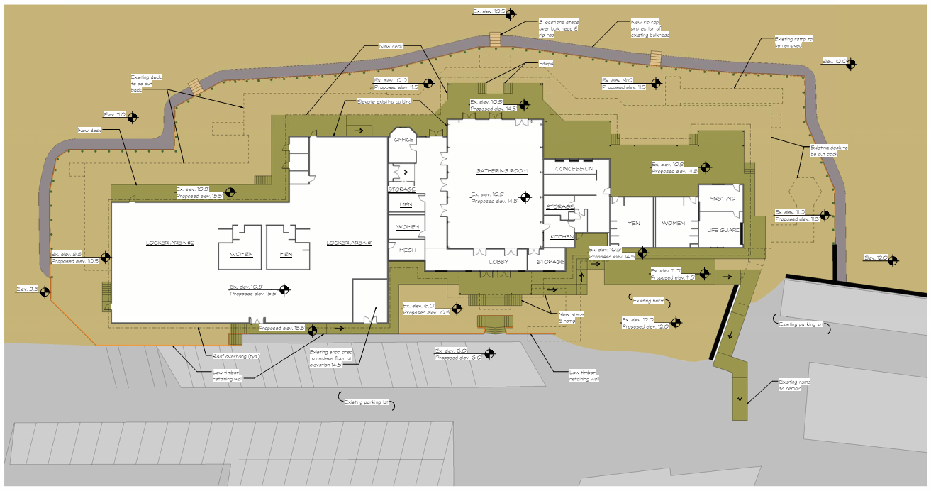
Option 7A – Floor Plan

Slide 27
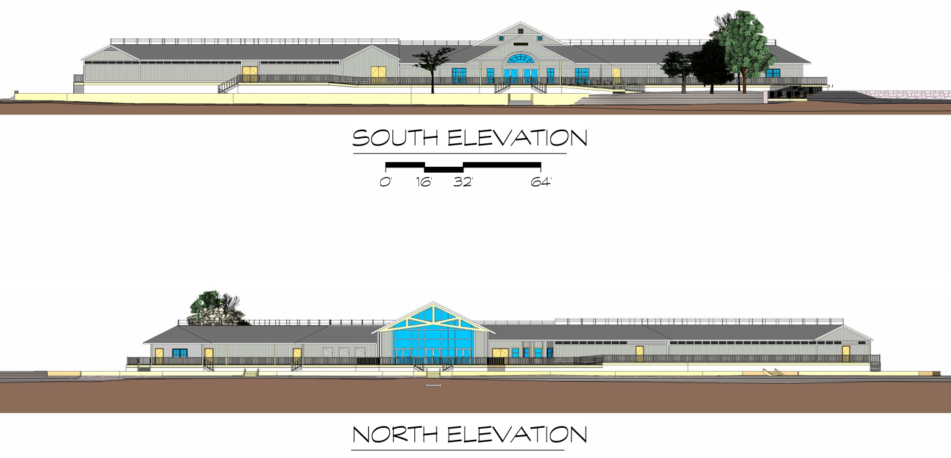
Option 7A – Elevations

Slide 28
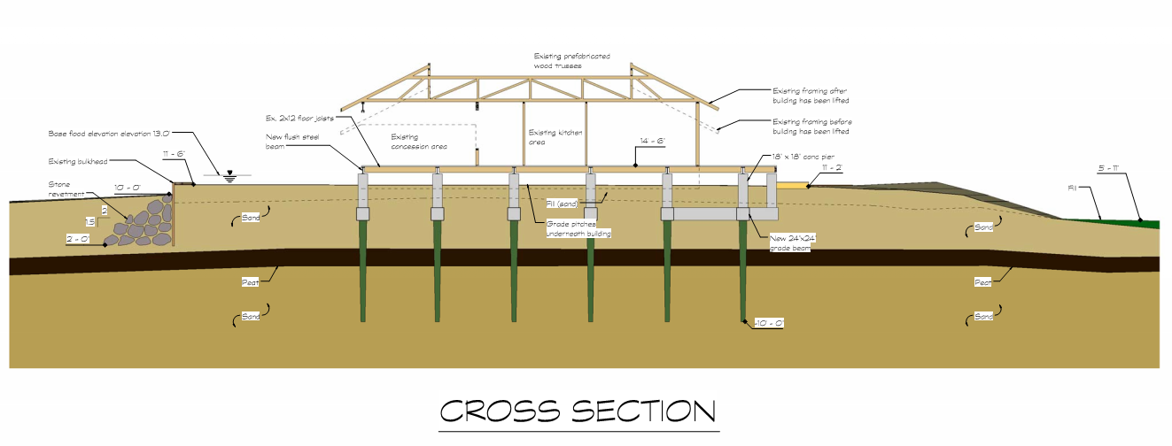
Option 7A – Sections

Slide 29
Option 7A – Renderings
View from the Southeast
View from the Southwest

Slide 30
Option 7A – Renderings
View from the Northwest

